Slide 1


7
Applications of Integration
Copyright © Cengage Learning. All rights reserved.

Slide 2
7.2
Volume: The Disk Method
Copyright © Cengage Learning. All rights reserved.

Slide 3
Objectives
Find the volume of a solid of revolution using the disk method.
Find the volume of a solid of revolution using the washer method.
Find the volume of a solid with known cross sections.

Slide 4
The Disk Method

Slide 5
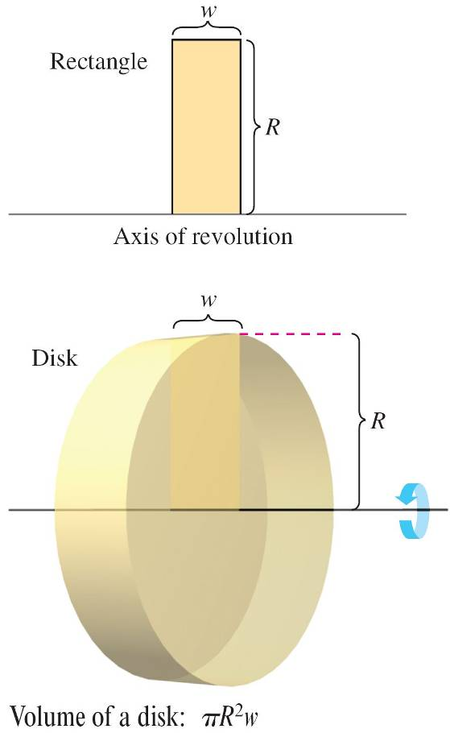
The Disk Method
If a region in the plane is revolved about a line, the resulting solid is a solid of revolution, and the line is called the axis of revolution.
The simplest such solid is a right
circular cylinder or disk, which is
formed by revolving a rectangle
about an axis adjacent to one
side of the rectangle,
as shown in Figure 7.13.
Figure 7.13

Slide 6
The Disk Method
The volume of such a disk is
Volume of disk = (area of disk)(width of disk)
= πR²w
where R is the radius of the disk and w is the width.

Slide 7
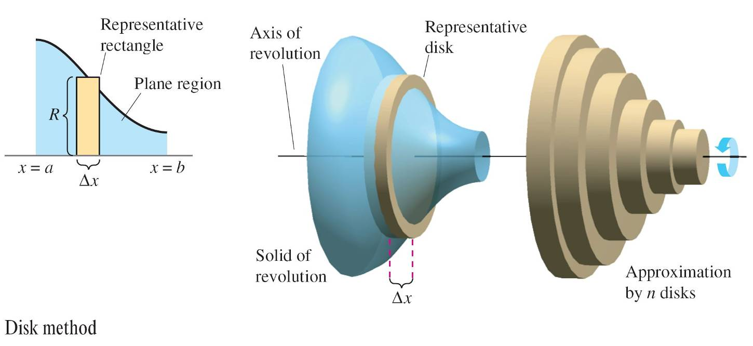
The Disk Method
To see how to use the volume of a disk to find the volume of a general solid of revolution, consider a solid of revolution formed by revolving the plane region in Figure 7.14 about the indicated axis.
Figure 7.14

Slide 8
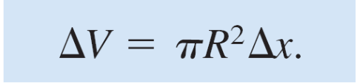
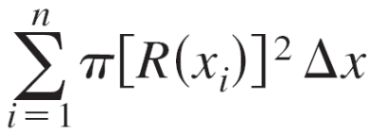
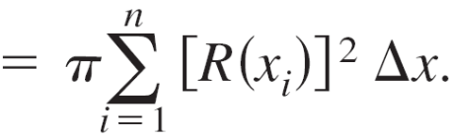
The Disk Method
To determine the volume of this solid, consider a representative rectangle in the plane region. When this rectangle is revolved about the axis of revolution, it generates a representative disk whose volume is
Approximating the volume of the solid by n such disks of width Δx and radius R(x_{i}) produces
Volume of solid ≈

Slide 9

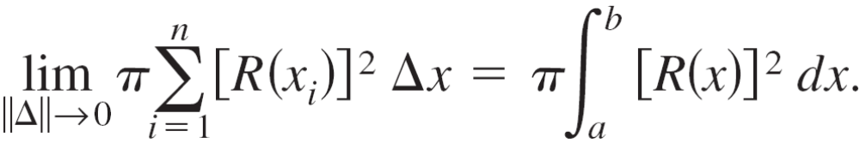
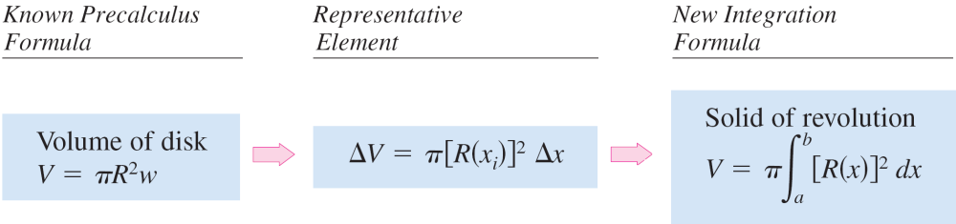
The Disk Method
This approximation appears to become better and better
as So, you can define the volume of the
solid as
  Volume of solid =
Schematically, the disk method looks like this.

Slide 10
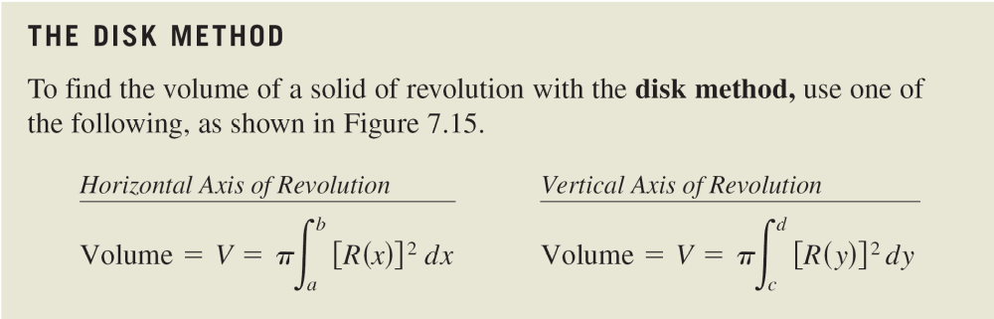
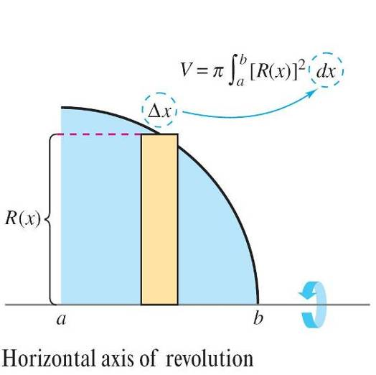
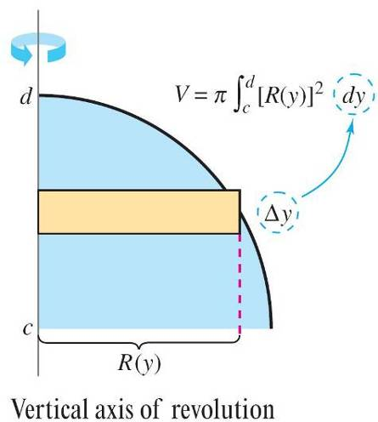
The Disk Method
A similar formula can be derived if the axis of revolution is vertical.
Figure 7.15

Slide 11

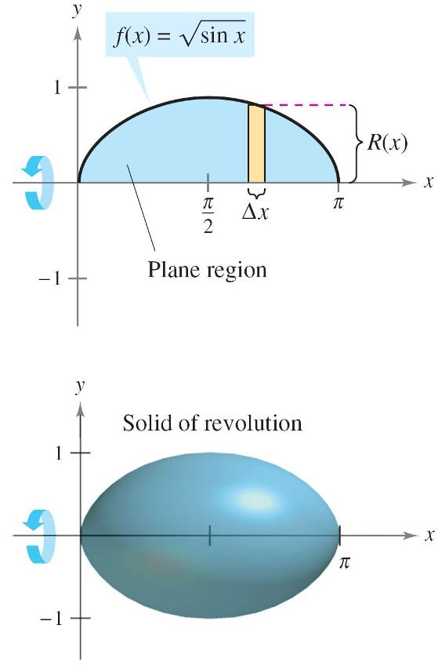

Example 1 – Using the Disk Method
Find the volume of the solid formed by revolving the region
bounded by the graph of and the x-axis
(0 ≤ x ≤ π) about the x-axis.
Solution:
From the representative
rectangle in the upper graph
in Figure 7.16, you can see that
the radius of this solid is
R(x) = f(x)
Figure 7.16

Slide 12
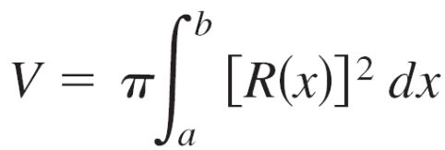
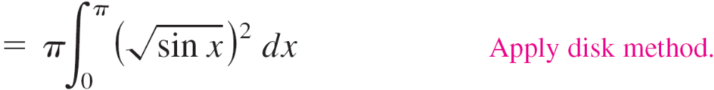
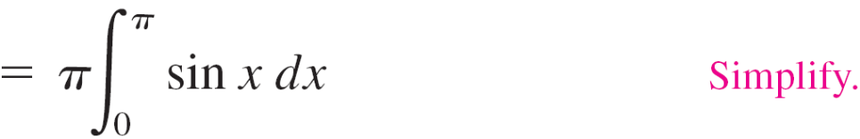
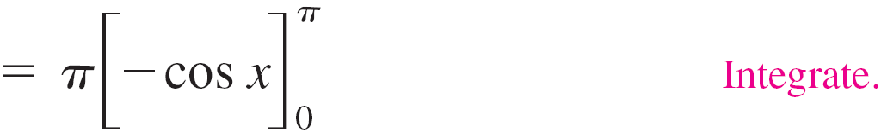


Example 1 – Solution
cont’d
So, the volume of the solid of revolution is

Slide 13
The Washer Method

Slide 14
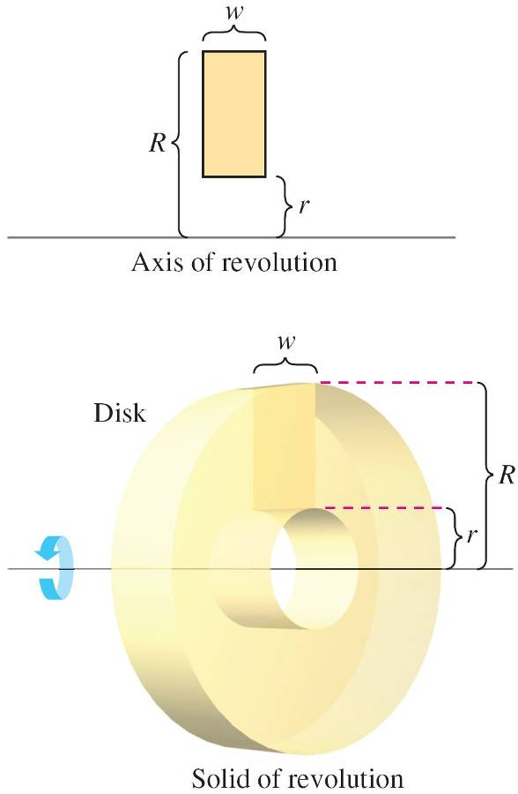
The Washer Method
The disk method can be extended to cover solids of revolution with holes by replacing the representative disk with a representative washer.
The washer is formed by revolving a rectangle about an axis, as shown in Figure 7.18.
If r and R are the inner and outer radii
of the washer and w is the width of the washer, the volume is given by
Volume of washer = π(R² – r²)w.
Figure 7.18

Slide 15
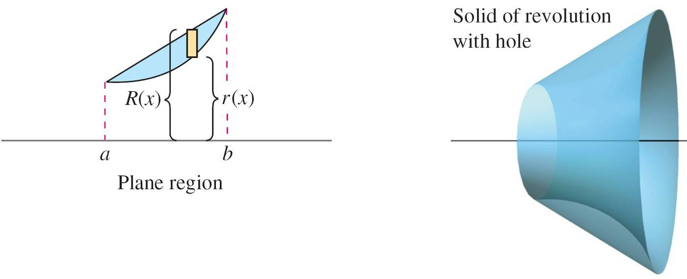
The Washer Method
To see how this concept can be used to find the volume of a solid of revolution, consider a region bounded by an outer radius R(x) and an inner radius r(x), as shown in Figure 7.19.
Figure 7.19

Slide 16
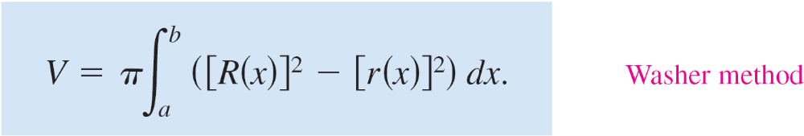
The Washer Method
If the region is revolved about its axis of revolution, the
volume of the resulting solid is given by
Note that the integral involving the inner radius represents
the volume of the hole and is subtracted from the integral
involving the outer radius.

Slide 17

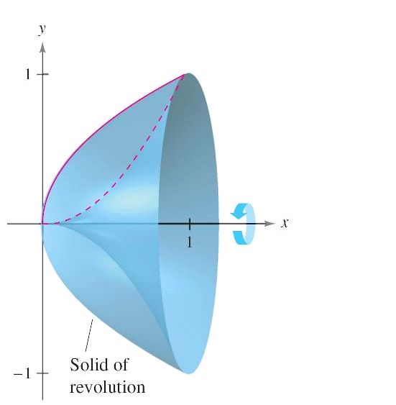
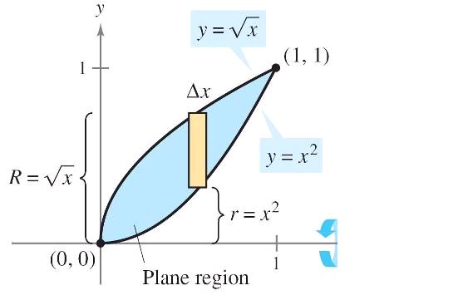

Example 3 – Using the Washer Method
Find the volume of the solid formed by revolving the region
bounded by the graphs of about the
x-axis, as shown in Figure 7.20.
Figure 7.20

Slide 18
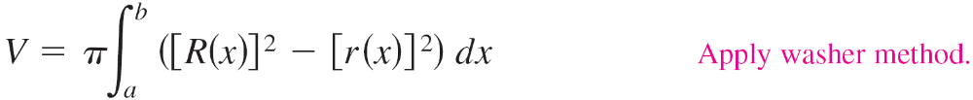
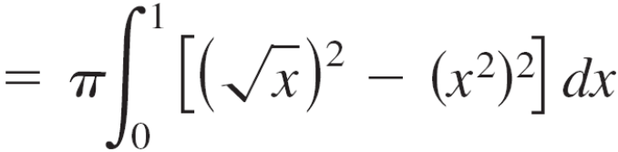
Example 3 – Solution
In Figure 7.20, you can see that the outer and inner radii are as follows.
Integrating between 0 and 1 produces

Slide 19
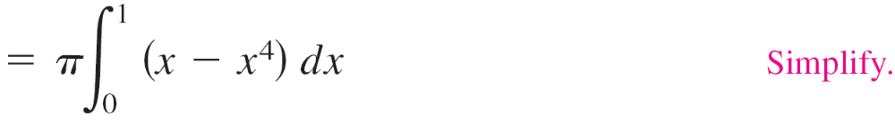
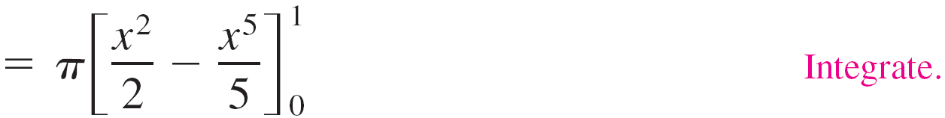
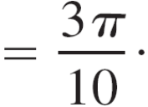
Example 3 – Solution
cont’d

Slide 20
The Washer Method
So far, the axis of revolution has been horizontal and you have integrated with respect to x. In the Example 4, the axis of revolution is vertical and you integrate with respect to y. In this example, you need two separate integrals to compute the volume.

Slide 21
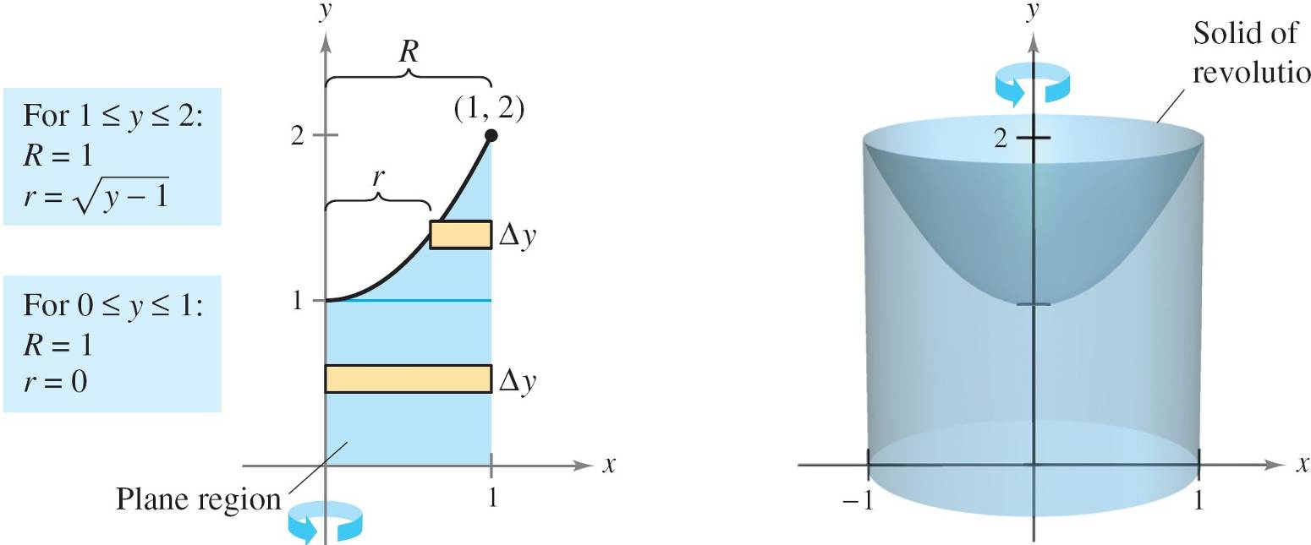
Example 4 – Integrating with Respect to y, Two-Integral Case
Find the volume of the solid formed by revolving the region bounded by the graphs of y = x² + 1, y = 0, x = 0, and x = 1 about y-axis, as shown in Figure 7.21.
Figure 7.21

Slide 22

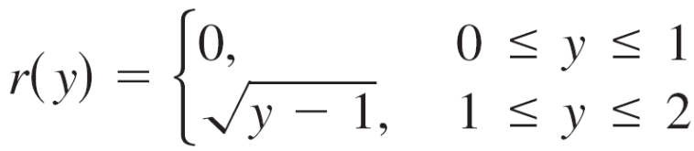
Example 4 – Solution
For the region shown in Figure 7.21, the outer radius is
simply R = 1.
There is, however, no convenient formula that represents
the inner radius.
When 0 ≤ y ≤ 1, r = 0, but when 1 ≤ y ≤ 2, r is determined
by the equation y = x² + 1, which implies that

Slide 23
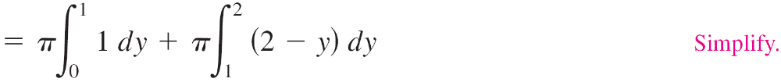
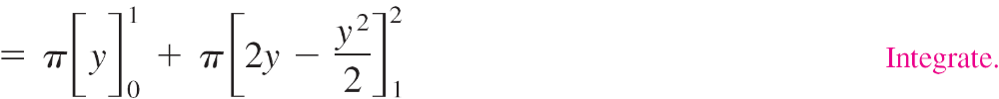
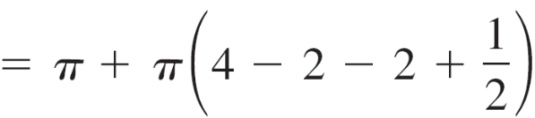
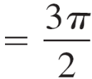
Example 4 – Solution
cont’d
Using this definition of the inner radius, you can use two integrals to find the volume.

Slide 24

Example 4 – Solution
cont’d
Note that the first integral represents the volume
of a right circular cylinder of radius 1 and height 1.
This portion of the volume could have been determined
without using calculus.

Slide 25
Solids with Known Cross Sections

Slide 26
Solids with Known Cross Sections
With the disk method, you can find the volume of a solid
having a circular cross section whose area is A = πR².
This method can be generalized to solids of any shape, as
long as you know a formula for the area of an arbitrary
cross section.
Some common cross sections are squares, rectangles,
triangles, semicircles, and trapezoids.

Slide 27
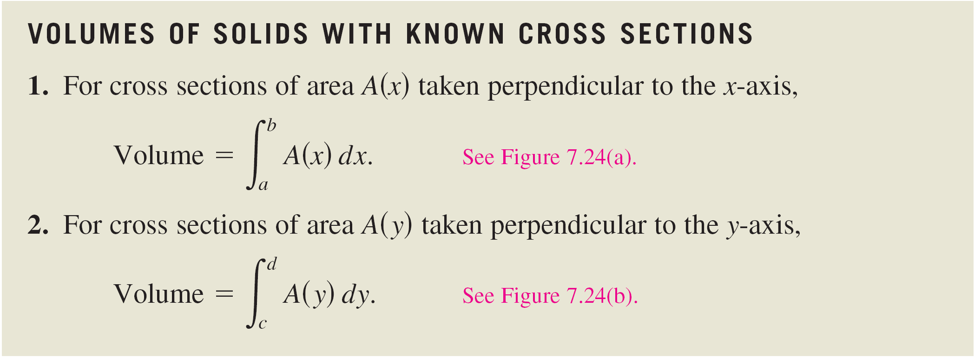
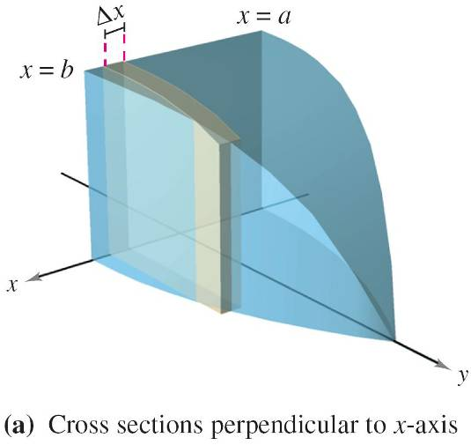
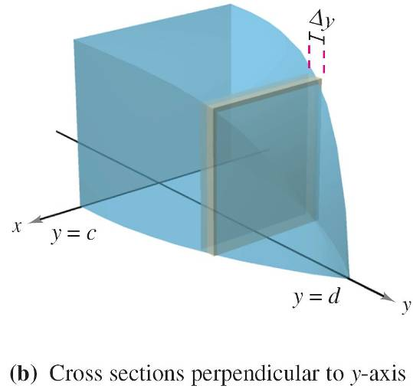
Solids with Known Cross Sections
Figure 7.24

Slide 28
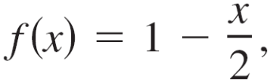
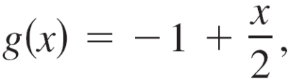
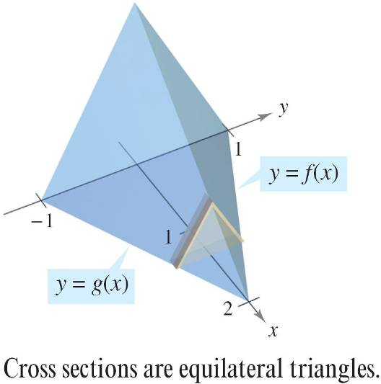
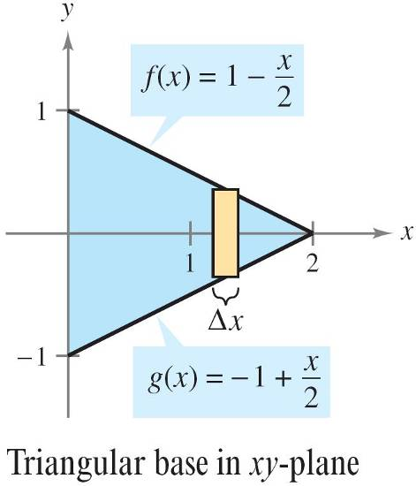
Example 6 – Triangular Cross Sections
Find the volume of the solid shown in Figure 7.25.
The base of the solid is the region bounded by the lines and x = 0.
The cross sections perpendicular to the x-axis are equilateral triangles.
Figure 7.25

Slide 29
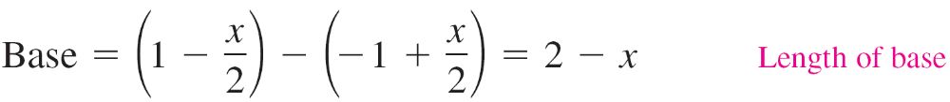
Example 6 – Solution
The base and area of each triangular cross section are as
follows.

Slide 30
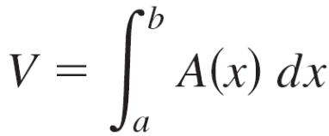
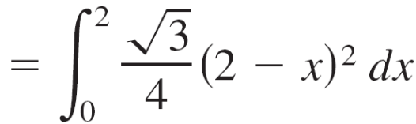
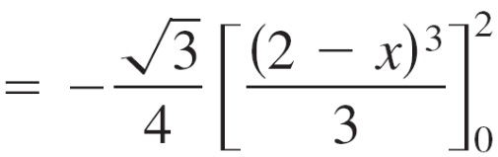
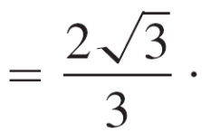
Example 6 – Solution
cont’d
Because x ranges from 0 to 2, the volume of the solid is

